Slide 1
Chapter 1: Exploring the Network
Introduction to Networks
Notes:
Cisco Networking Academy program
Introduction to Networks
Chapter 1: Exploring the Network

Slide 2
Chapter 1: Objectives
After completing this chapter, students will be able to:
Explain how multiple networks are used in everyday life.
Explain the topologies and devices used in a small- to medium-sized business network.
Explain the basic characteristics of a network that supports communication in a small- to medium-sized business.
Explain trends in networking that will affect the use of networks in small to medium-sized businesses.
Notes:
2

Slide 3
Chapter 1
1.1 Globally Connected
1.2 LANs, WANs, and the Internet
1.3 The Network as a Platform
1.4 The Changing Network Environment
1.5 Summary
Notes:
Chapter 1 Sections

Slide 4
1.1 Globally Connected
Notes:
Cisco Networking Academy program
Introduction to Networks
Chapter 1: Exploring the Network

Slide 5
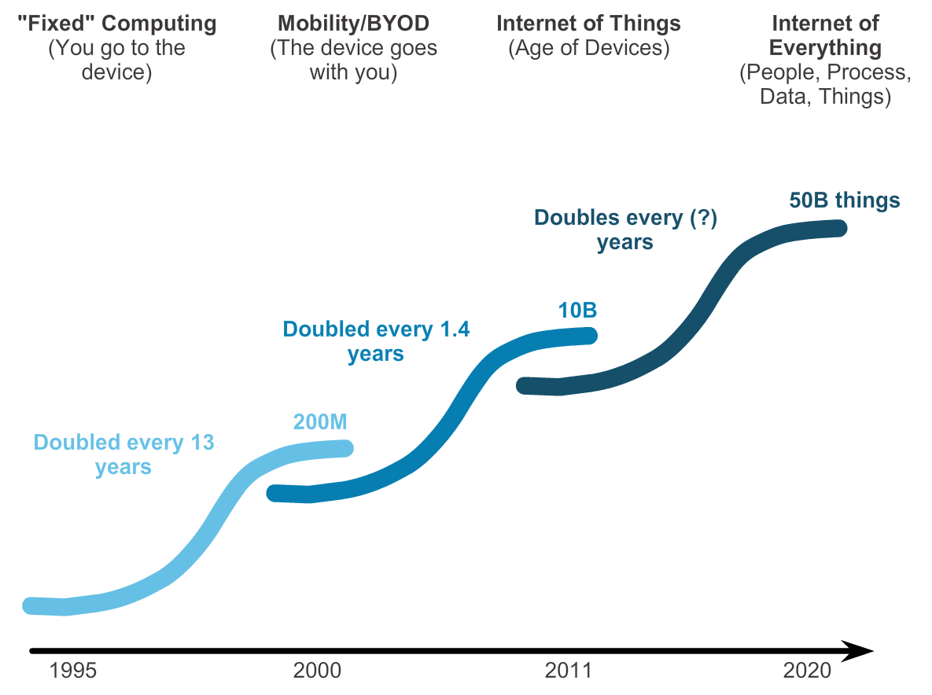
Networking Today Networks in Our Past and Daily Lives
Notes:
1.1.1.1 Networks in Our Daily Lives
1.1.1.2 Technology Then and Now

Slide 6
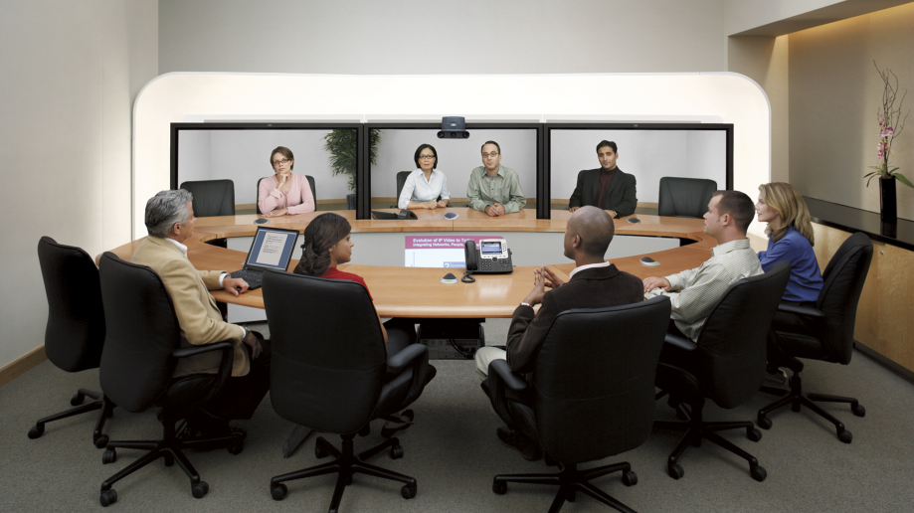
Networking Today The Global Community
Notes:
1.1.1.3 The Global Community

Slide 7
Interconnecting Our Lives Networking Impacts in Our Daily Lives
Networks support the way we learn.
Networks support the way we communicate.
Networks support the way we work.
Networks support the way we play.
Notes:
1.1.1.4 Networks Support the Way We Learn
1.1.1.5 Networks Support the Way We Communicate
1.1.1.6 Networks Support the Way We Work
1.1.1.7 Networks Support the Way We Play

Slide 8
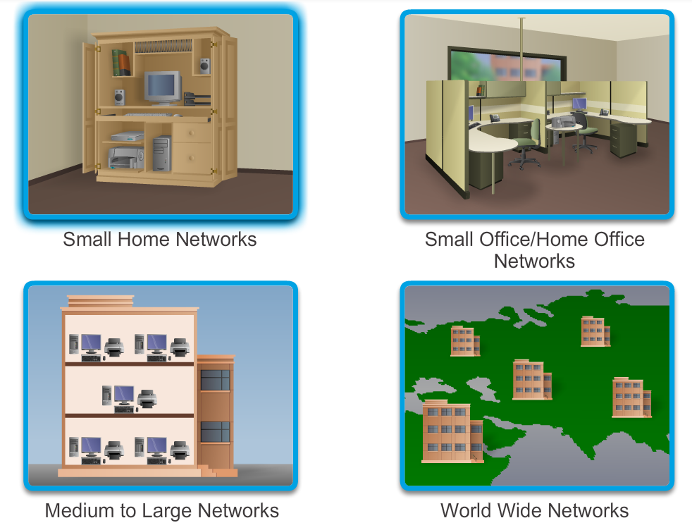
Providing Resources in a Network Networks of Many Sizes
Notes:
1.1.2.1 Networks of Many Sizes

Slide 9
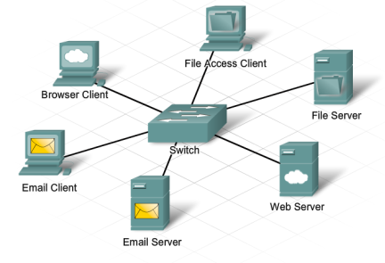
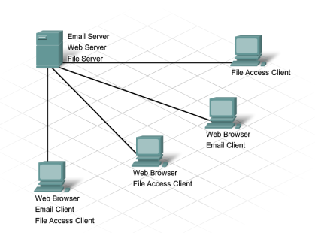
Providing Resources in a Network Clients and Servers
Notes:
1.1.2.2 Clients and Servers
1.1.2.3 Clients and Servers (Cont.)

Slide 10
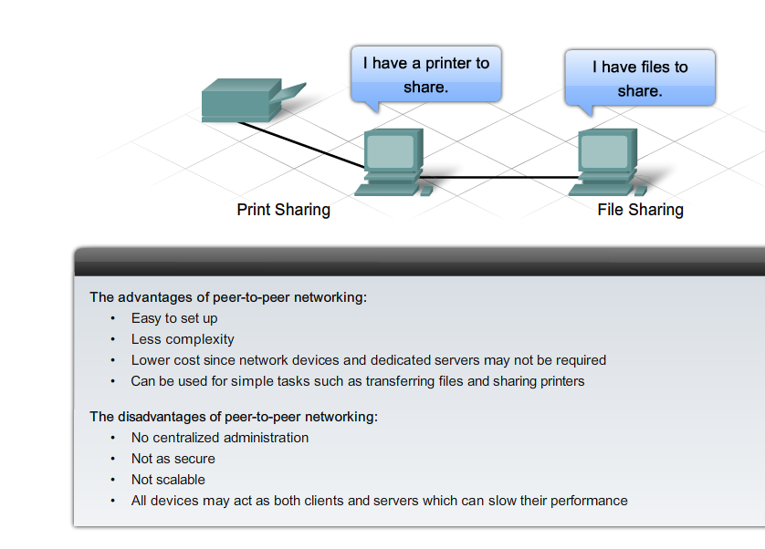
Providing Resources in a Network Peer-to-Peer
Notes:
1.1.2.4 Peer-to-Peer

Slide 11
1.2 LANs, WANs, and the Internet
Notes:
Cisco Networking Academy program
Introduction to Networks
Chapter 1: Exploring the Network

Slide 12
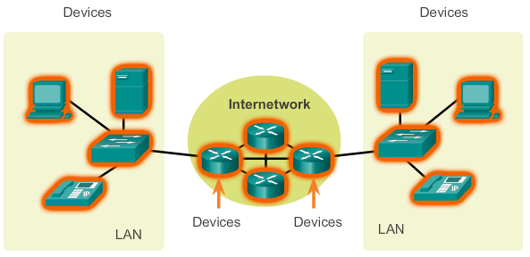
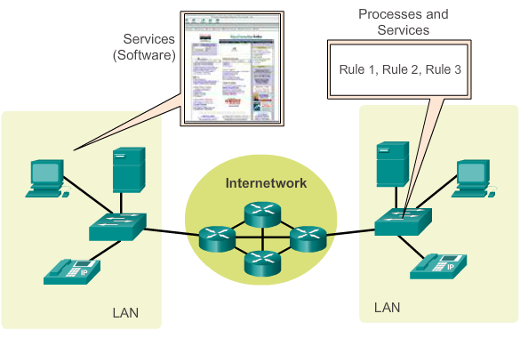
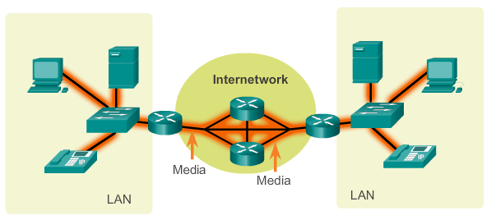
LANs, WANs, and Internets Components of a Network
There are three categories of network components:
Devices
Media
Services
Notes:
1.2.1.1 Components of the Network

Slide 13
Components of a Network End Devices
Some examples of end devices are:
Computers (work stations, laptops, file servers, web servers)
Network printers
VoIP phones
TelePresence endpoint
Security cameras
Mobile handheld devices (such as smart phones, tablets, PDAs, and wireless debit / credit card readers and barcode scanners)
Notes:
1.2.1.2 End Devices

Slide 14
Components of a Network Network Infrastructure Devices
Examples of intermediary network devices are:
Network Access Devices (switches, and wireless access points)
Internetworking Devices (routers)
Security Devices (firewalls)
Notes:
1.2.1.3 Intermediary Network Devices

Slide 15
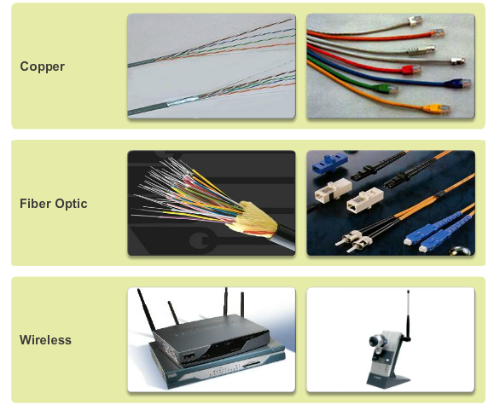
Components of a Network Network Media
Notes:
1.2.1.4 Network Media

Slide 16
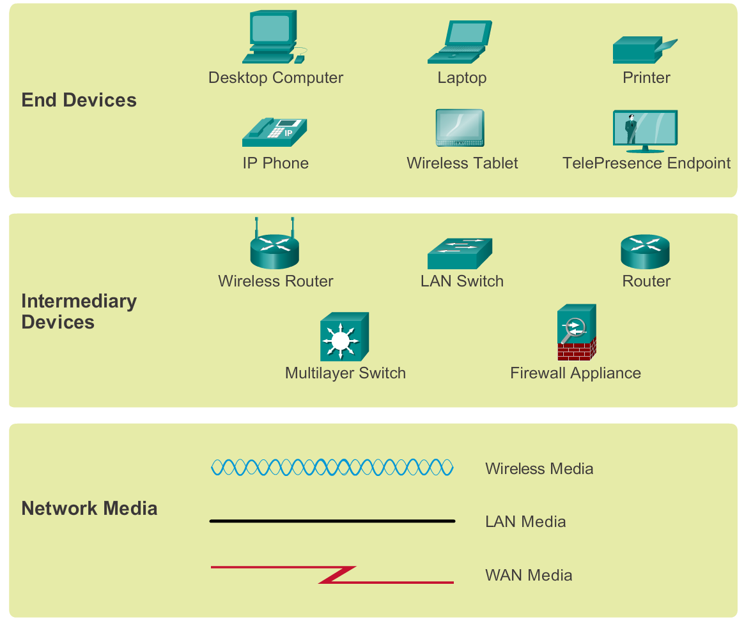
Components of a Network Network Representations
Notes:
1.2.1.5 Network Representations

Slide 17
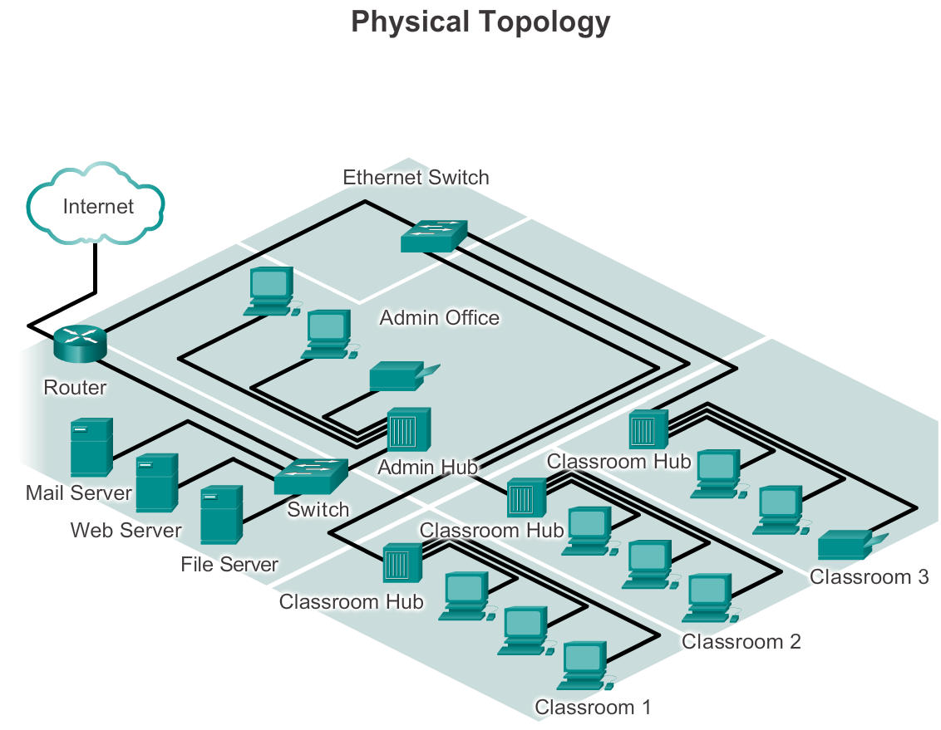
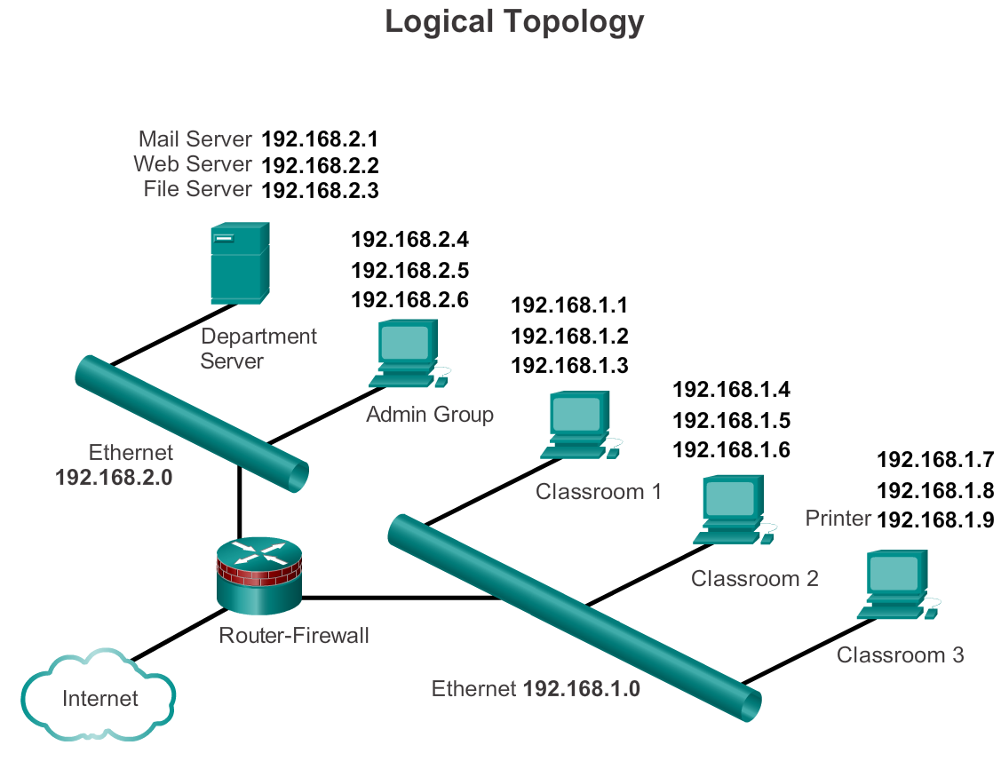
Components of a Network Topology Diagrams
Notes:
1.2.1.6 Topology Diagrams

Slide 18
LANs and WANs Types of Networks
The two most common types of network infrastructures are:
Local Area Network (LAN)
Wide Area Network (WAN).
Other types of networks include:
Metropolitan Area Network (MAN)
Wireless LAN (WLAN)
Storage Area Network (SAN)
Notes:
1.2.2.1 Types of Networks

Slide 19
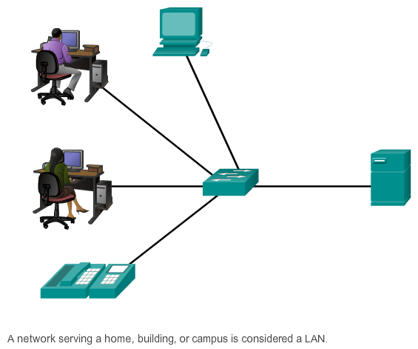
LANs and WANs Local Area Networks (LAN)
Notes:
1.2.2.2 Local Area Networks

Slide 20
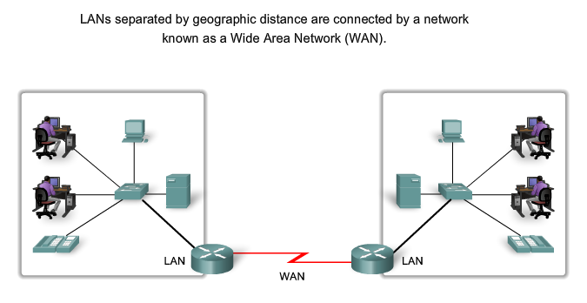
LANs and WANs Wide Area Networks (WAN)
Notes:
1.2.2.3 Wide Area Networks

Slide 21
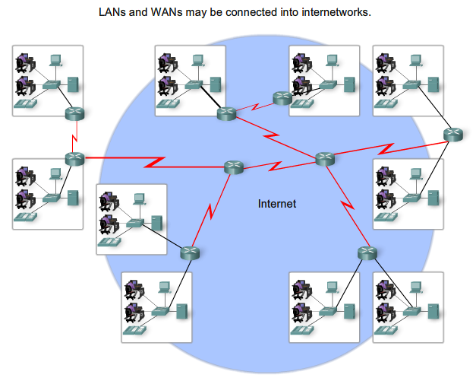
LANs, WANs, and the Internet The Internet
Notes:
1.2.3.1 The Internet

Slide 22
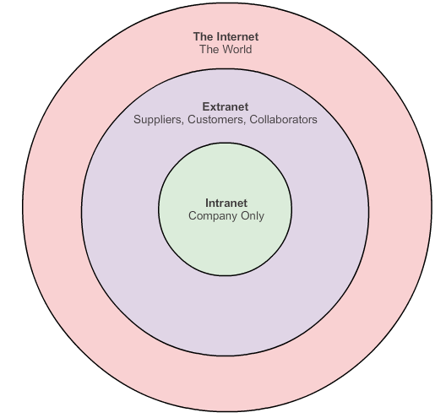
LANs, WANs, and the Internet Intranet and Extranet
Notes:
1.2.3.2 Intranet and Extranet

Slide 23
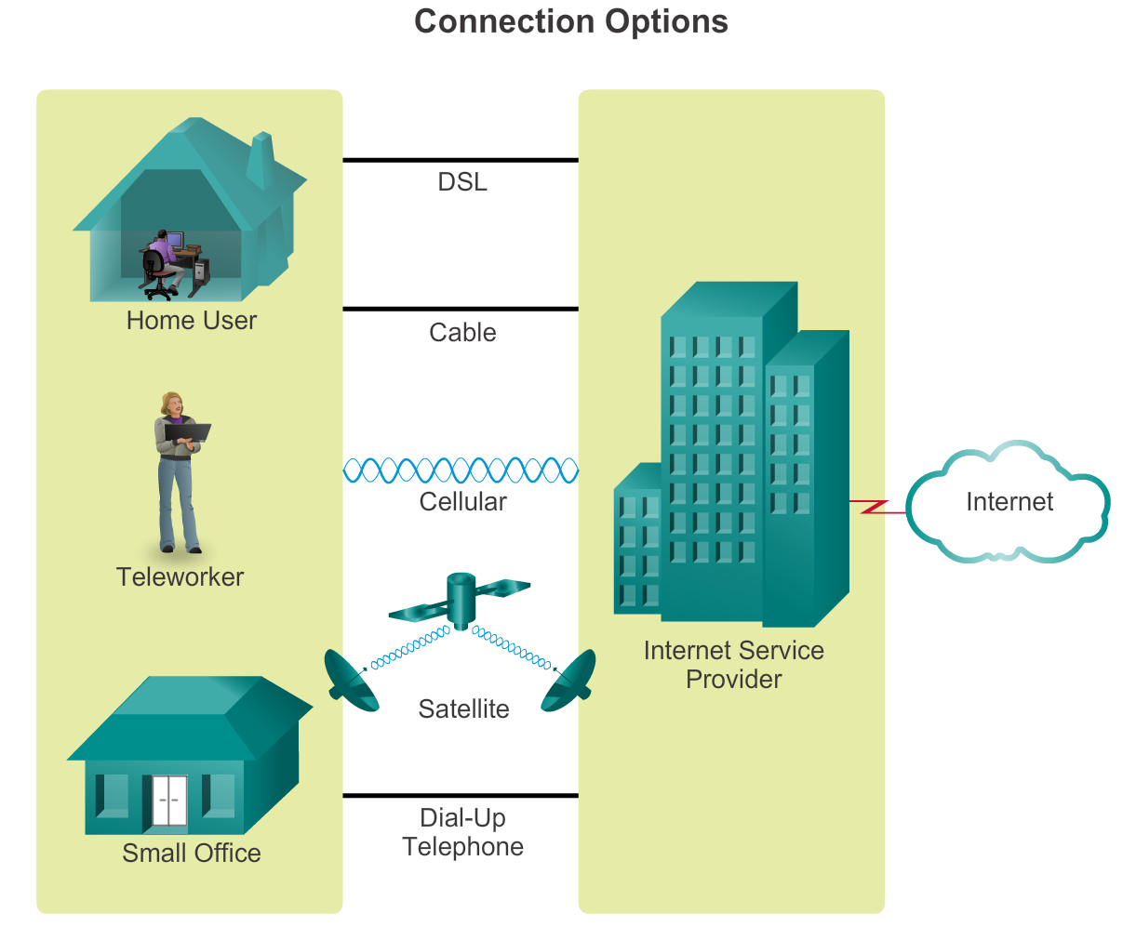
Connecting to the Internet Connecting Remote Users to the Internet
Notes:
1.2.4.1 Internet Access Technologies
1.2.4.2 Connecting Remote Users to the Internet

Slide 24
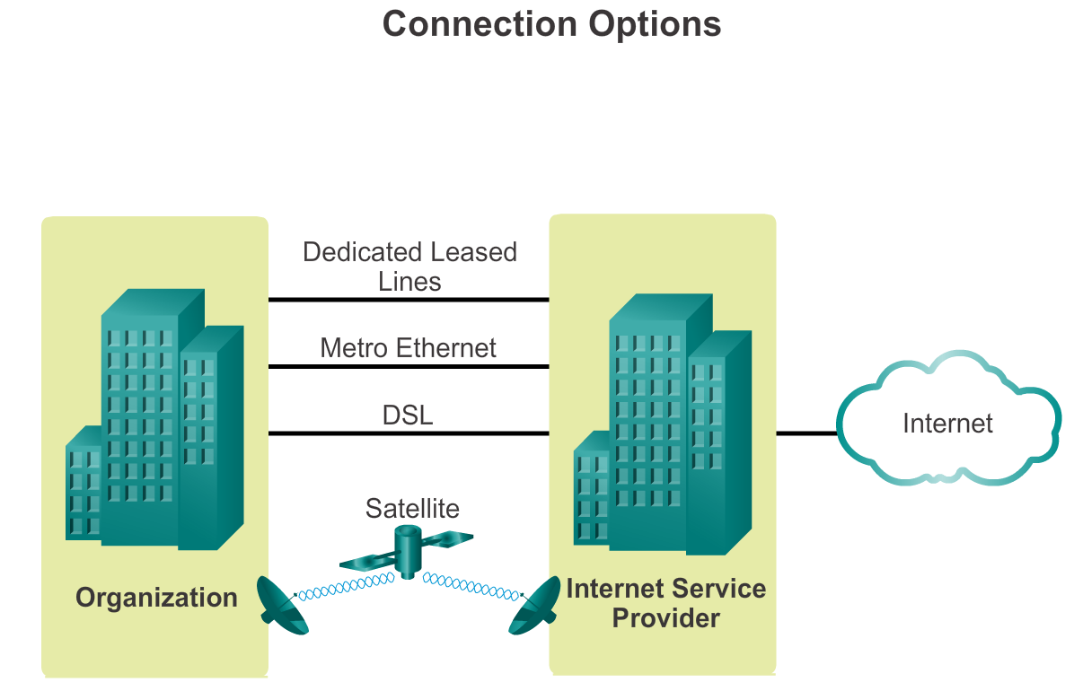
Connecting to the Internet Connecting Businesses to the Internet
Notes:
1.2.4.1 Internet Access Technologies
1.2.4.3 Connecting Businesses to the Internet

Slide 25
1.3 The Network as a Platform
Notes:
Cisco Networking Academy program
Introduction to Networks
Chapter 1: Exploring the Network

Slide 26
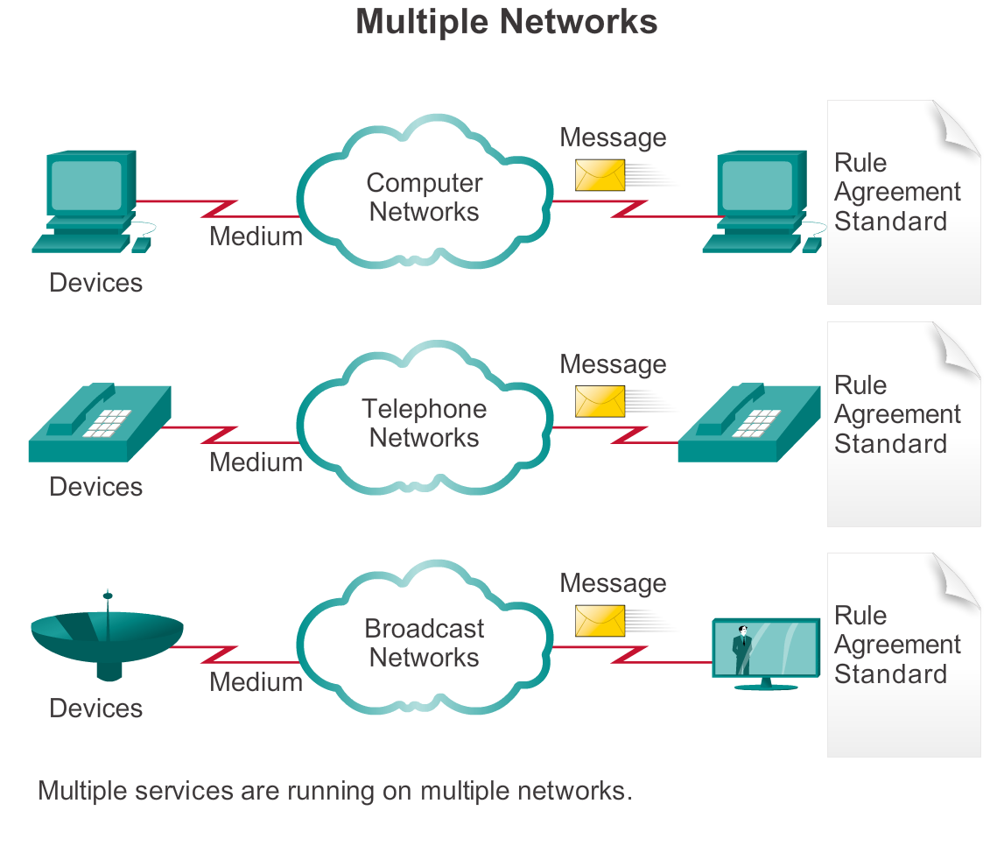
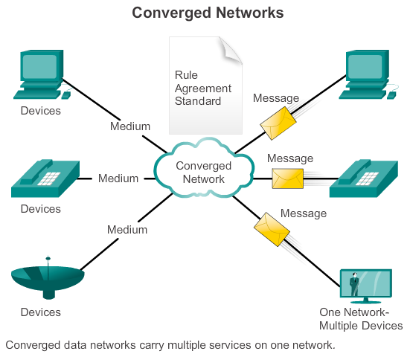
Converged Networks The Converging Network
Notes:
1.3.1.1 The Converging Network

Slide 27
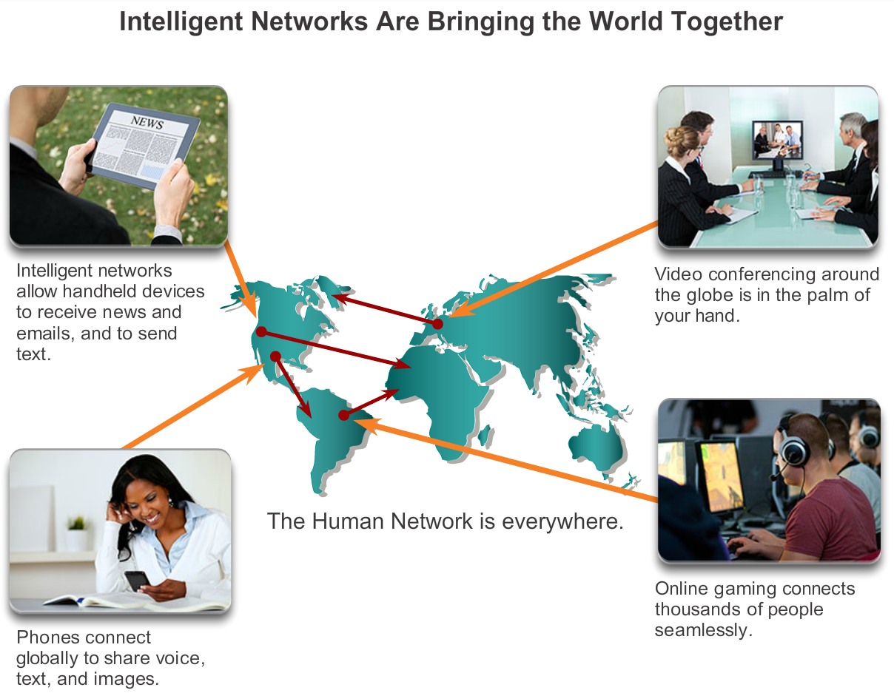
Converged Networks Planning for the Future
Notes:
1.3.1.2 Planning for the Future

Slide 28
Reliable Network Supporting Network Architecture
As networks evolve, we are discovering that there are four basic characteristics that the underlying architectures need to address in order to meet user expectations:
Fault Tolerance
Scalability
Quality of Service (QoS)
Security
Notes:
1.3.2.1 The Supporting Network Architecture

Slide 29
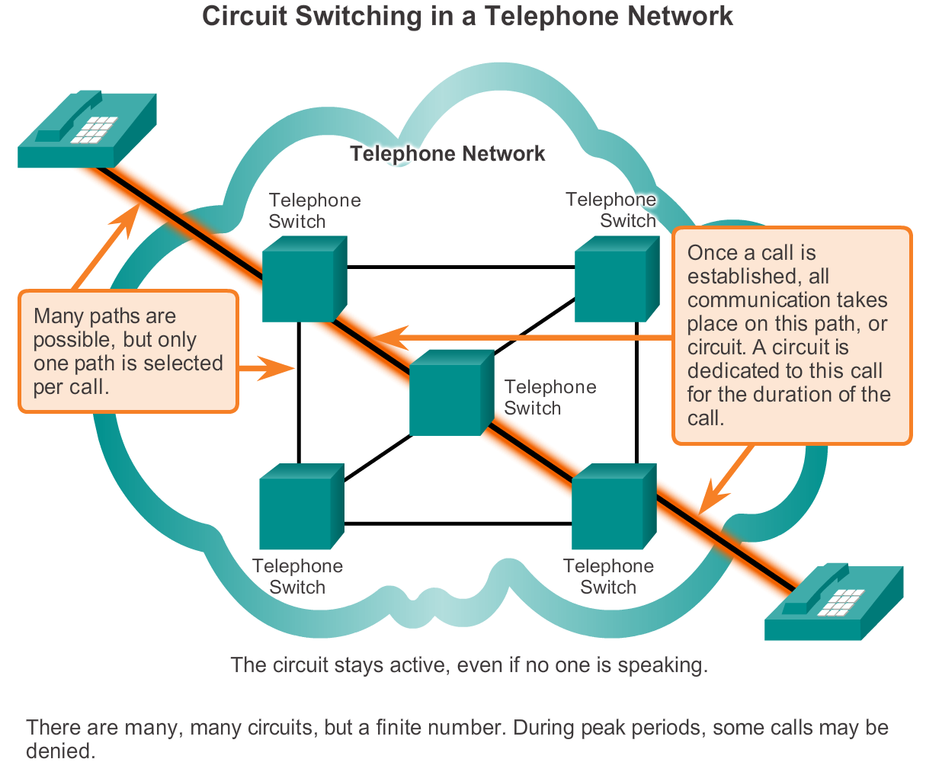
Reliable Network Fault Tolerance in Circuit Switched Network
Notes:
1.3.2.2 Fault Tolerance in Circuit Switched Networks

Slide 30
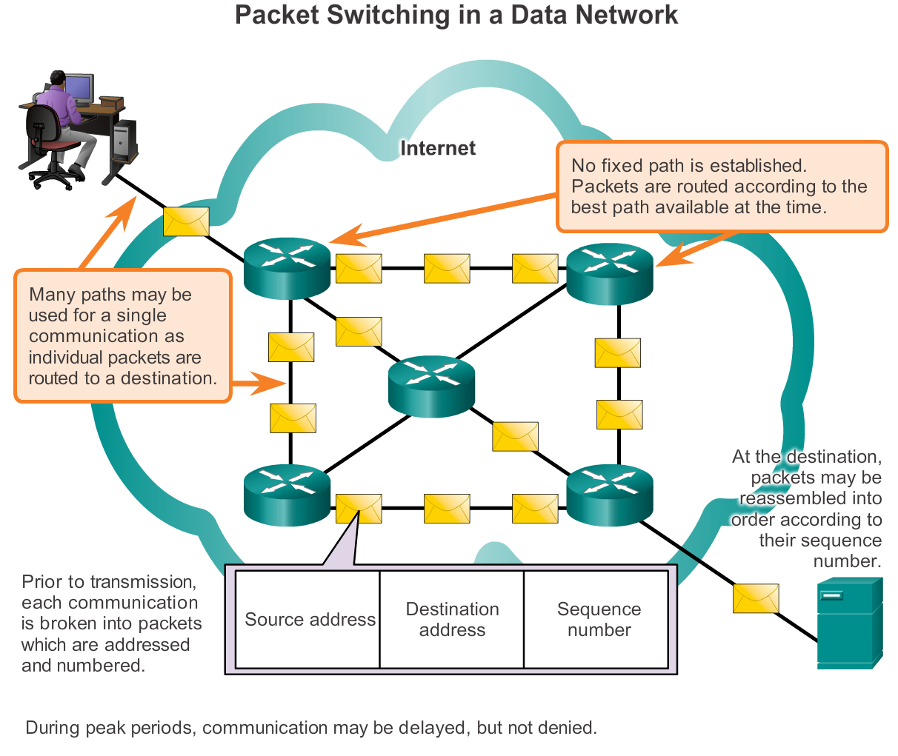
Reliable Network Packet-Switched Networks
Notes:
1.3.2.3 Fault Tolerance in Packet-Switched Networks

Slide 31
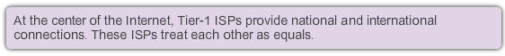
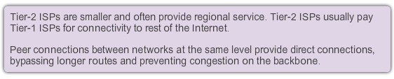
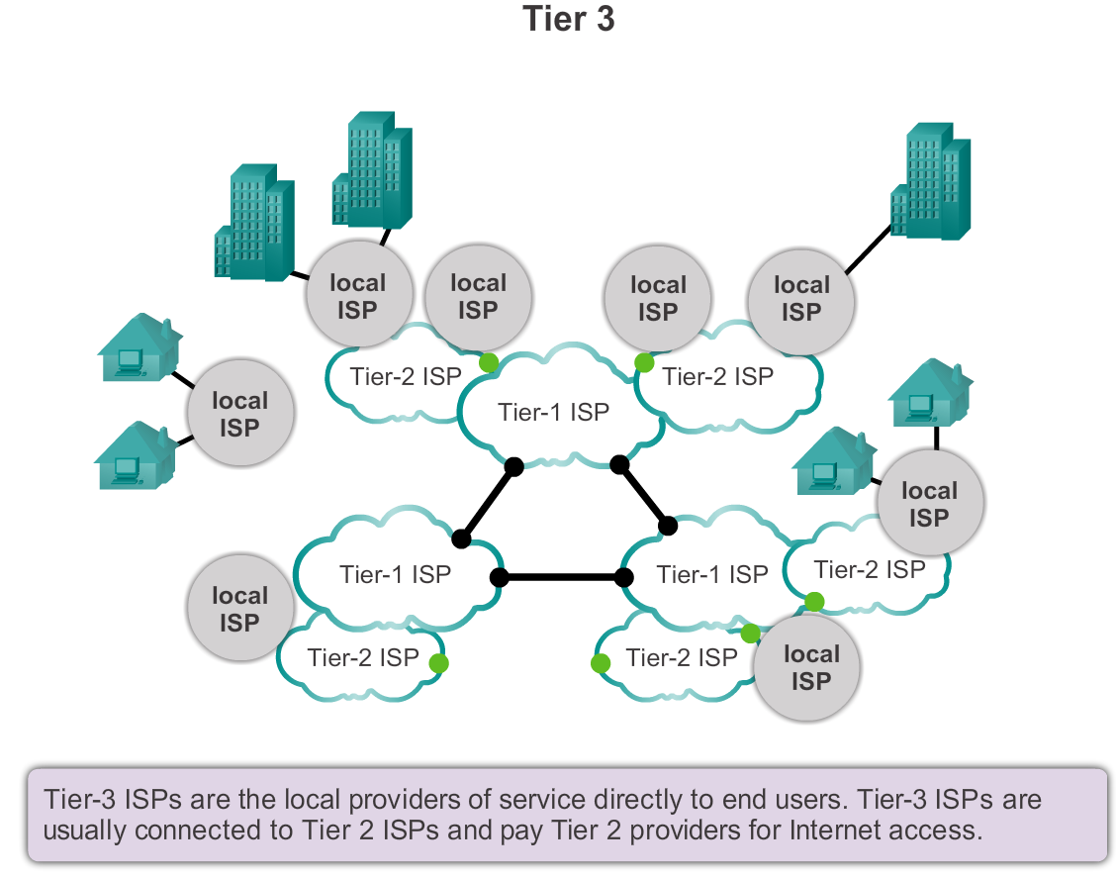
Reliable Network Scalable Networks
Notes:
1.3.2.4 Scalable Networks

Slide 32
Reliable Network Providing QoS
Examples of priority decisions for an organization might include:
Time-sensitive communication - increase priority for services like telephony or video distribution.
Non time-sensitive communication - decrease priority for web page retrieval or email.
High importance to organization - increase priority for production control or business transaction data.
Undesirable communication - decrease priority or block unwanted activity, like peer-to-peer file sharing or live entertainment.
Notes:
1.3.2.5 Providing QoS

Slide 33
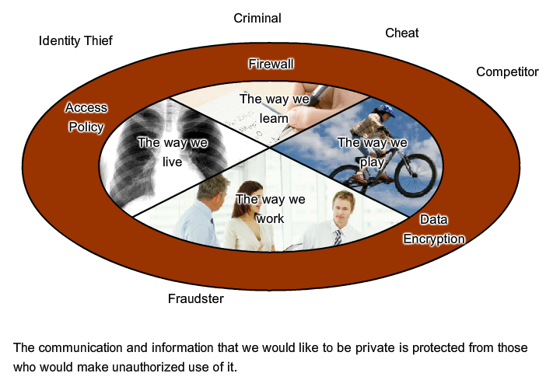
Reliable Network Providing Network Security
Notes:
1.3.2.6 Providing Network Security

Slide 34
1.4 The Changing Network Environment
Notes:
Cisco Networking Academy program
Introduction to Networks
Chapter 1: Exploring the Network

Slide 35
Network Trends New trends
Some of the top trends include:
Bring Your Own Device (BYOD)
Online collaboration
Video
Cloud computing
Notes:
1.4.1.1 New Trends

Slide 36

Network Trends Bring Your Own Device (BYOD)
The concept of any device, to any content, in anyway is a major global trend that requires significant changes to the way devices are used. This trend is known as Bring Your Own Device (BYOD).
Notes:
1.4.1.2 BYOD

Slide 37
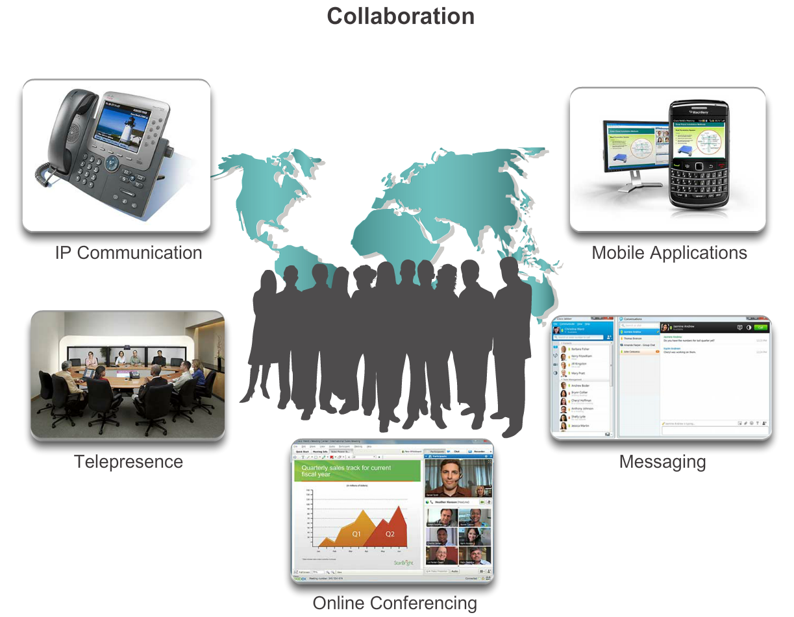
Network Trends Online Collaboration
Notes:
1.4.1.3 Online Collaboration

Slide 38
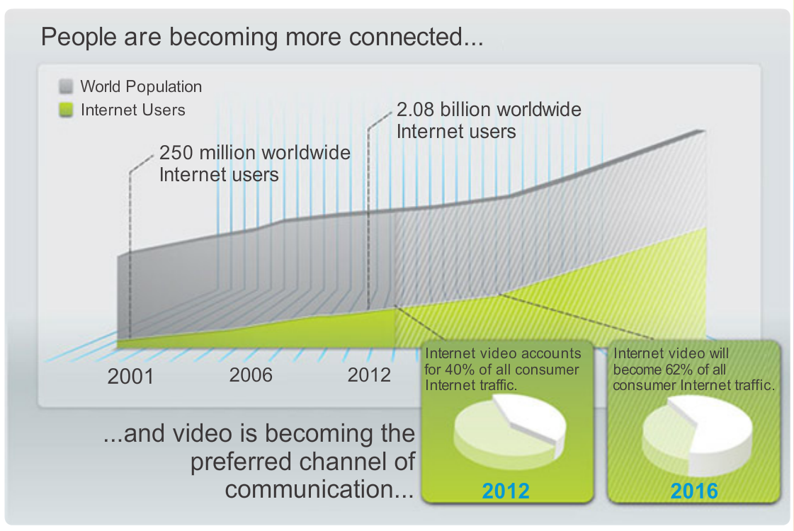
Network Trends Video Communication
Notes:
1.4.1.4 Video Communication

Slide 39
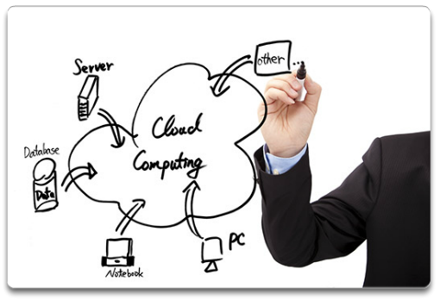
Network Trends Cloud Computing
Cloud computing offers the following potential benefits:
Organizational flexibility
Agility and rapid deployment
Reduced cost of infrastructure
Refocus of IT resources
Creation of new business models
Notes:
1.4.1.5 Cloud Computing

Slide 40
Network Trends Data Centers
A data center is a facility used to house computer systems and associated components including:
Redundant data communications connections
High-speed virtual servers (sometimes referred to as server farms or server clusters)
Redundant storage systems (typically uses SAN technology)
Redundant or backup power supplies
Environmental controls (e.g., air conditioning, fire suppression)
Security devices
Notes:
1.4.1.6 Data Centers

Slide 41
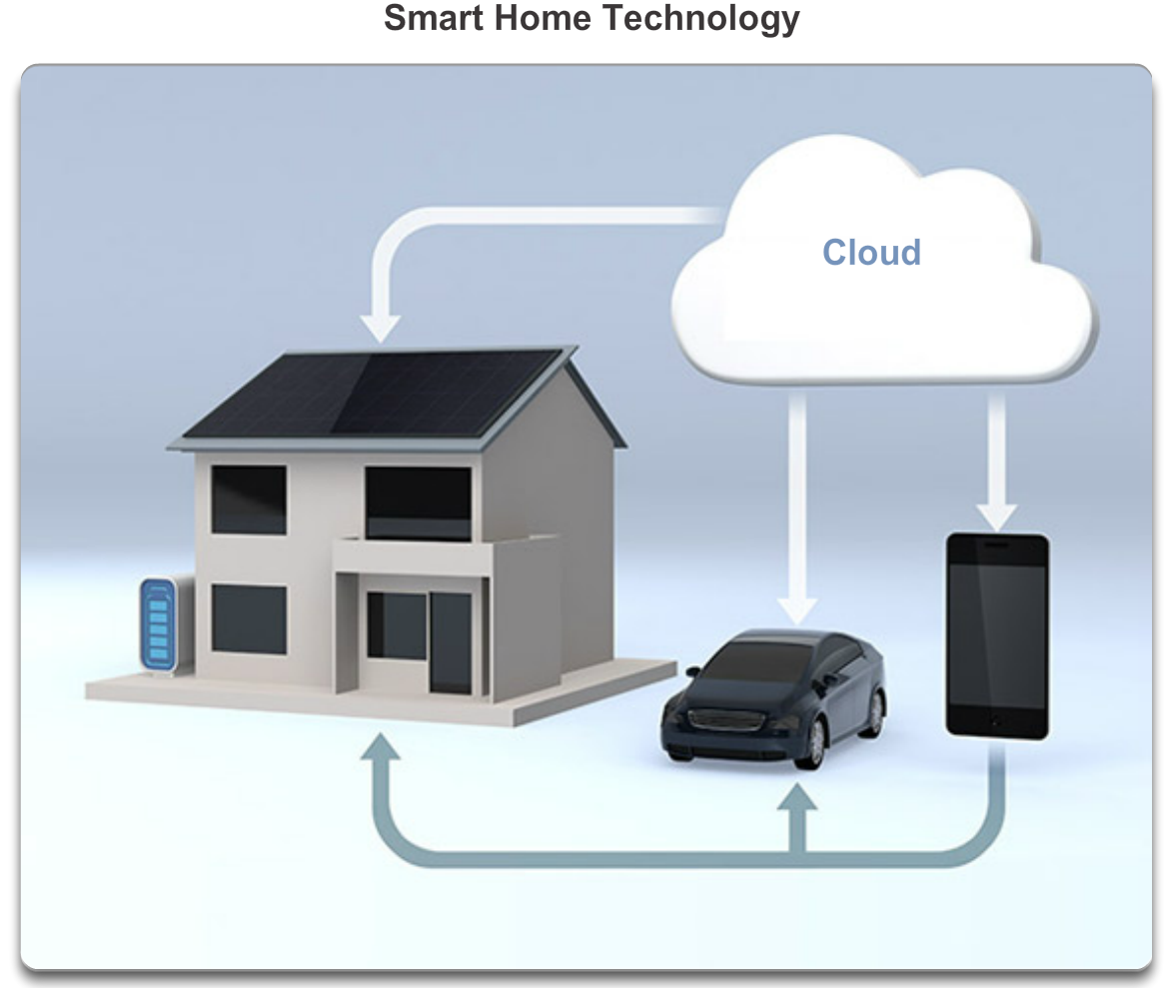
Networking Technologies for the Home Technology Trends in the Home
Notes:
1.4.2.1 Technology Trends in the Home

Slide 42
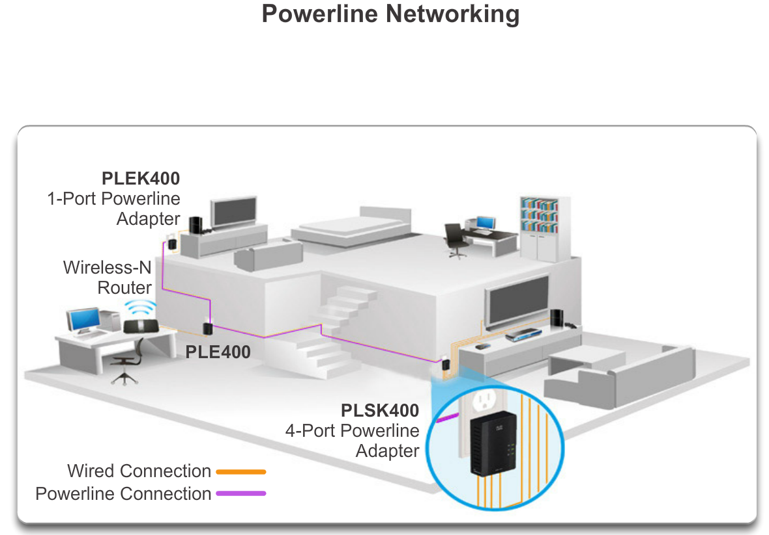
Networking Technologies for the Home Powerline Networking
Notes:
1.4.2.2 Powerline Networking

Slide 43
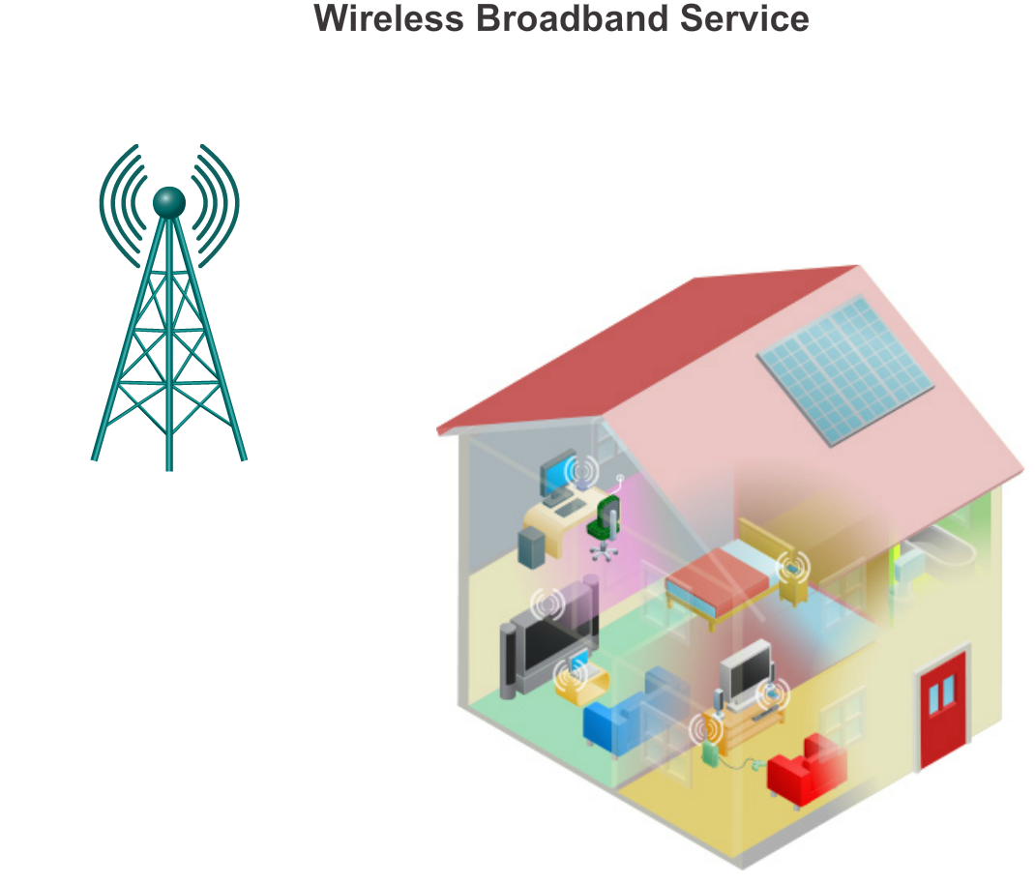
Networking Technologies for the Home Wireless Broadband
Notes:
1.4.2.3 Wireless Broadband

Slide 44
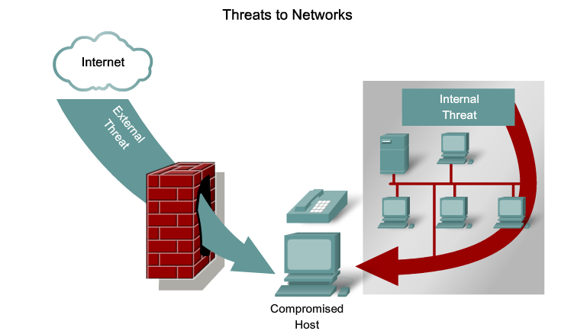
Future of Networking Network Security
Notes:
1.4.3.1 Security threats

Slide 45
Network Security Security Threats
The most common external threats to networks include:
Viruses, worms, and Trojan horses
Spyware and adware
Zero-day attacks, also called zero-hour attacks
Hacker attacks
Denial of service (DoS) attacks
Data interception and theft
Identity theft
Notes:
1.4.3.1 Security threats (cont.)

Slide 46
Network Security Security Solutions
Network security components often include:
Antivirus and antispyware
Firewall filtering
Dedicated firewall systems
Access control lists (ACL)
Intrusion prevention systems (IPS)
Virtual Private Networks (VPNs)
Notes:
1.4.3.2 Security Solutions

Slide 47
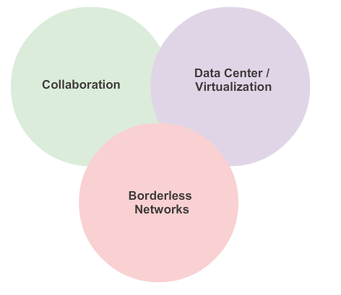
Network Architectures Cisco Network Architectures
Notes:
1.4.4.1 Cisco Network Architectures

Slide 48
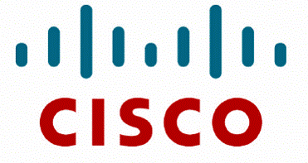
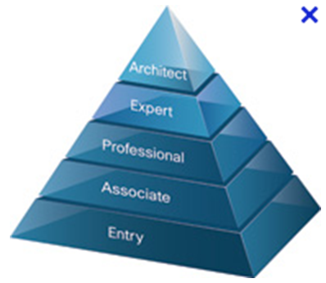
Network Architectures Cisco Certified Network Associate (CCNA)
Notes:
1.4.4.2 CCNA

Slide 49
Exploring the Networking Summary
In this chapter, you learned:
Networks and the Internet have changed the way we communicate, learn, work, and even play.
Networks come in all sizes. They can range from simple networks consisting of two computers, to networks connecting millions of devices.
The Internet is the largest network in existence. In fact, the term Internet means a ‘network of networks. The Internet provides the services that enable us to connect and communicate with our families, friends, work, and interests.
The network infrastructure is the platform that supports the network. It provides the stable and reliable channel over which communication can occur. It is made up of network components including end devices, intermediate devices, and network media.
Notes:
Chapter I Summary

Slide 50
Exploring the Networking Summary (cont.)
In this chapter, you learned:
Networks must be reliable.
Network security is an integral part of computer networking, regardless of whether the network is limited to a home environment with a single connection to the Internet, or as large as a corporation with thousands of users.
The network infrastructure can vary greatly in terms of size, number of users, and number and types of services that are supported on it. The network infrastructure must grow and adjust to support the way the network is used. The routing and switching platform is the foundation of any network infrastructure.
Notes:
Chapter 12 Summary (cont.)

Slide 51


